Slide 1
Flight Delay Analysis
Domain: Aviation

Slide 2
Project Group Members
MR. U.A VARUN PRASAD
MRS. AKANKSHA MODY
MRS. SHIVANGI KAUSHIK
MISS. KEERTHANA KUNDAPUR
MISS. PRIYA RAMESH SHINDE
PROJECT MENTOR: SHUBHAM SIR

Slide 3




TOOLS USED:
EXCEL
MYSQL
TABLEAU
POWER BI

Slide 4
KPI’S
Weekday Vs Weekend total flights statistics.
Total number of cancelled flights for JetBlue Airways on first date of every month.
Week wise, State wise and City wise statistics of delay of flights with airline details.
Number of airlines with No departure/arrival delay with distance covered between 2500 and 3000.

Slide 5
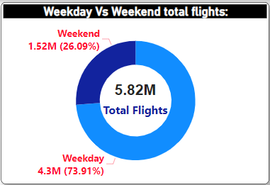
KPI 1

Slide 6
Conclusion:
In weekend there is only 26% of Flights and in weekdays there are 74% flights. So here we can say that weekdays flights are more compare to weekend flights, may be because flight tickets are more expensive on weekend compare to weekdays.
The top 5 Airlines for both weekdays as well as weekend are: Southwest, Delta, American, SkyWest and Atlantic Airlines.

Slide 7
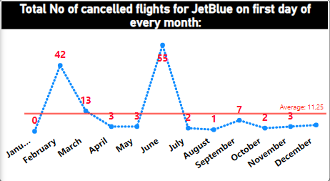
KPI 2

Slide 8
Conclusion:
June month has 55 number of cancelled flights, So this month has the highest number of cancellation of flights compare to other months.
The maximum cancellation of flights are on month June because of bad weather condition as well as June month is very busy season for Flights.
There are 46 cancellation of flights for National Air System Delay, 7 cancellation of flights for carrier Delay and 2 cancellation of flights for weather Delay.
The maximum Flights were cancelled from origin Airport i.e. John F. Kennedy International Airport(JFK) to destination airport Gen. Edward Lawrence Logan International Airport(BOS).

Slide 9
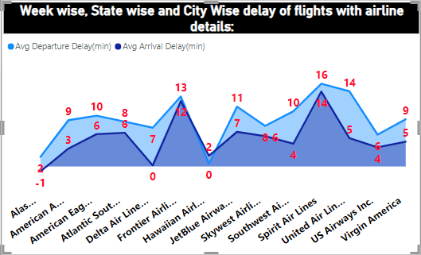
KPI 3

Slide 10
Conclusion:
Spirit airlines delayed the most due to airline delay and Southwest Airlines co. Cancelled the most due to bad weather.
Most common reason for the delay is Airline delay.
Mostly all airlines got cancelled due to bad weather.
According to the state, on an average maximum delays were in Delaware(DE) because it is a small regional airport.

Slide 11
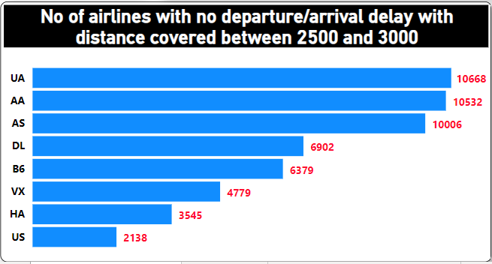
KPI 4

Slide 12
Conclusion:
UA airlines has the highest number of flights, followed by AA and AS this shows passenger preferred these 3 in their priority list for long distance travel without any delay.
US airlines is the least preferred airlines since it has 2k airlines under it and passengers do not go with this much ,might be due to higher average delay in some of these airlines.

Slide 13
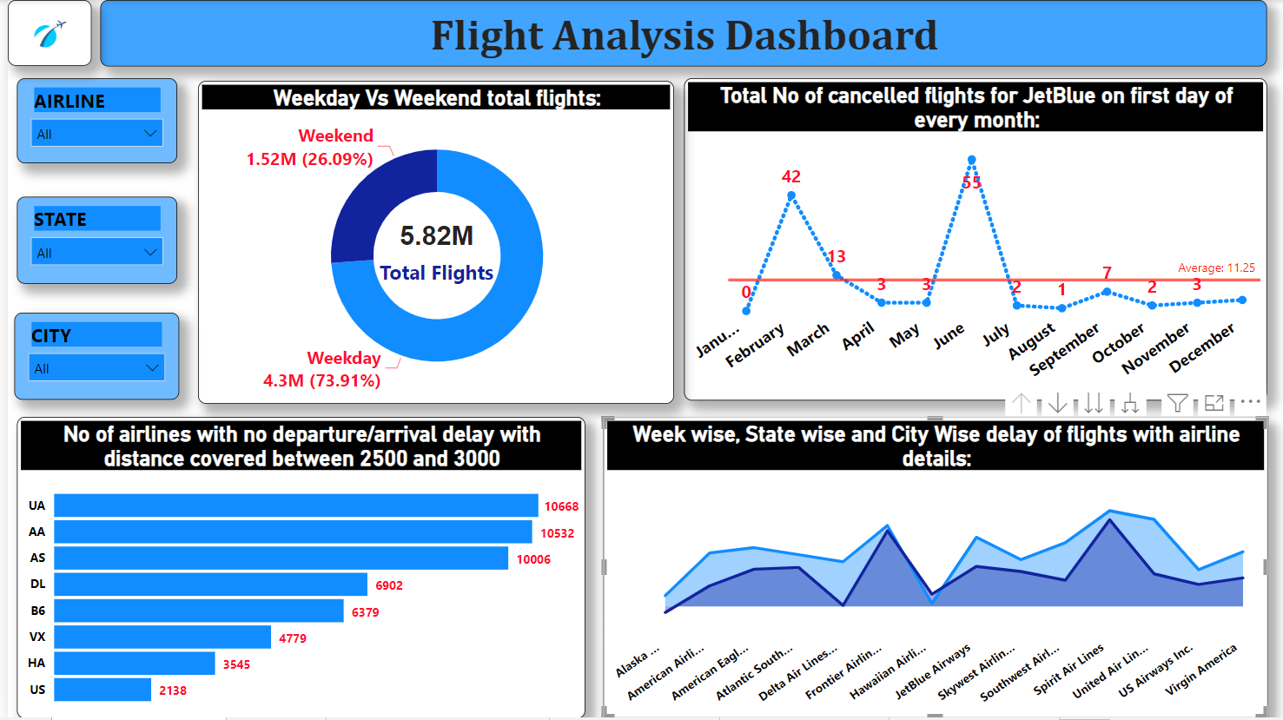
Dashboard

Slide 14
Conclusion
Bad Weather Condition is the main reason for the maximum number of cancellation of Flights.
Airline delay is the main reason for the maximum number of delays in Flights.
Southwest Airlines co. is the most cheapest airline among all the airlines hence the frequency of this airline is maximum and therefore cancellations are also maximum.

Slide 15
Thank You!!

